Slide 1

DATABASE
TECHNOLOGIES
Relational model, Storage formats
and Indexing
Suresh Jamadagni
Department of Computer Science
and Engineering

Slide 2

DATABASE TECHNOLOGIES
Relational model, Storage formats and Indexing
Suresh Jamadagni
Department of Computer Science and Engineering

Slide 3
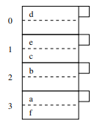
DATABASE TECHNOLOGIES
Index Structure – Hash Tables
Hash tables are also used as data structure for indexes
A hash function h takes a search key (hash key) as an argument and computes from it an integer in the range 0 to B −1, where B is the number of buckets
A bucket array, is an array indexed from 0 to B −1, holds the headers of B linked lists, one for each bucket of the array
If a record has search key K, then we store the record by linking it to the bucket list for the bucket numbered h(K).

Slide 4
DATABASE TECHNOLOGIES
Index Structure – Hash Tables
Example:
Assume that a block can hold only two records, and that B = 4
The hash function h returns values from 0 to 3.
Keys are letters a through f .
Assume that h(d) = 0, h(c) = h(e) = 1, h(b) = 2, and h(a) = h(f) = 3.
Thus, the six records are distributed into blocks as shown

Slide 5
DATABASE TECHNOLOGIES
Index Structure – Hash Tables
Choice of Hash Function:
The hash function should “hash” the key so the resulting integer is a seemingly random function of the key. Thus, buckets will tend to have equal numbers of records, which improves the average time to access a record
When keys are integers, compute the remainder of K/B, where K is the key value and B is the number of buckets. Often, B is chosen to be a prime or a power of 2.
For character string search keys, treat each character as an integer, sum these integers, and take the remainder of the sum divided by the number of buckets B

Slide 6
DATABASE TECHNOLOGIES
Index Structure – Hash Tables
Insertion into Hash Table:
Consider a new record with search key K to be inserted
Compute h(K)
If the bucket numbered h(K) has space, insert the record into the block for this bucket
If none of the blocks of the chain for bucket h(K) has room, add a new overflow block to the chain and store the new record there

Slide 7
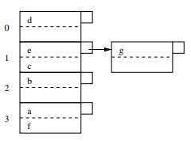
DATABASE TECHNOLOGIES
Index Structure – Hash Tables
Example of insertion into Hash Table:
Consider a new record with search key g to be inserted
h(g) = 1. Therefore new record is to be added to the bucket numbered 1.
Since there is no room in the block for bucket 1, add a new block and chain it to the original block of bucket 1
Add the record with key g in the new block

Slide 8
DATABASE TECHNOLOGIES
Index Structure – Hash Tables
Deletion from a Hash Table:
Consider a record with search key K to be deleted
Compute h(K) and identify the bucket and the block
Delete the record with key value K
Move records around in the block to consolidate the blocks of the bucket

Slide 9
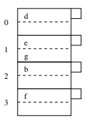
DATABASE TECHNOLOGIES
Index Structure – Hash Tables
Example of deletion from a Hash Table:
Consider key = c to be deleted
h(c) = 1. Therefore new record to be deleted from bucket numbered 1.
Identify the block containing the record with key = c in the blocks of bucket 1
Delete the record with key = c
Since there is room to move the record with key g from the second block of the chain to the first, move the record and delete the second block

Slide 10
DATABASE TECHNOLOGIES
Index Structure – Hash Tables
Efficiency of Hash Table Indexes:
If there are enough buckets that most of them fit on one block, then the lookup takes only one disk I/O, and insertion or deletion from the file takes only two disk I/O’s.
If the file grows, then there are many blocks in the chain for a typical bucket. Then we need to search long lists of blocks, taking at least one disk I/O per block. Thus, there is a good reason to keep the number of blocks per bucket low.

Slide 11
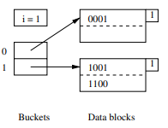
DATABASE TECHNOLOGIES
Index Structure – Hash Tables
Extensible Hash Tables:
One of the approaches to dynamic hashing where B is allowed to vary.
There is a level of indirection for the buckets. An array of pointers to blocks represents the buckets, instead of the array holding the data blocks.
The array of pointers can grow. Its length is always a power of 2, so in a growing step the number of buckets doubles.
Buckets can share a block if the total number of records in those buckets can fit in the block
The hash function h computes for each key a sequence of k bits for some large k, say 32. The bucket numbers at all times use some smaller number of bits, say i bits, from the beginning or end of this sequence. The bucket array will have 2^{i} entries when i is the number of bits used.

Slide 12
DATABASE TECHNOLOGIES
Index Structure – Hash Tables
Example of Extensible Hash Tables:
Consider k = 4, the hash function produces a sequence of only four bits
Only one of these bits is used, i = 1
The bucket array therefore has only two entries, one for 0 and one for 1
The bucket array entries point to two blocks.
The first holds all the records whose search keys hash to a bit sequence that begins with 0
The second holds all the records whose search keys hash to a bit sequence that begins with 1

Slide 13
DATABASE TECHNOLOGIES
Index Structure – Hash Tables
Insertion into Extensible Hash Tables:
To insert a record with search key K, compute h(K), take the first i bits of this bit sequence, and go to the entry of the bucket array indexed by these i bits.
Follow the pointer in this entry of the bucket array and arrive at a block B
If there is room in block B, put the new record in block B
If there is no room, then there are two possibilities, depending on the number j, which indicates how many bits of the hash value are used to determine membership in block B

Slide 14
DATABASE TECHNOLOGIES
Index Structure – Hash Tables
Insertion into Extensible Hash Tables:
If j < i, then nothing needs to be done to the bucket array:
Split block B into two.
Distribute records in B to the two blocks, based on the value of their (j + 1) ^{st} bit — records whose key has 0 in that bit stay in B and those with 1 there go to the new block.
Put j + 1 in each block’s “nub” (header) to indicate the number of bits used to determine membership.
Adjust the pointers in the bucket array so entries that formerly pointed to B now point either to B or the new block, depending on their (j + 1) ^{st} bit.

Slide 15
DATABASE TECHNOLOGIES
Index Structure – Hash Tables
Insertion into Extensible Hash Tables:
If j = i, increment i by 1. This will double the length of the bucket array. Now it will have 2^{i+1} entries
Suppose w is a sequence of i bits indexing one of the entries in the previous bucket array
In the new bucket array, the entries indexed by both w0 and w1 each point to the same block that the w entry used to point to.
The two new entries share the block and the block itself does not change. Membership in the block is still determined by whatever number of bits was previously used
Split block B as in case 1 since i is now greater than j

Slide 16
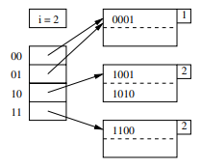
DATABASE TECHNOLOGIES
Index Structure – Hash Tables
Example of Insertion into Extensible Hash Tables:
Consider inserting a record whose key hashes to the sequence 1010
Since the first bit is 1, this record belongs in the second block. However, that block is already full, so it needs to be split
Since j = i = 1, we first need to double the bucket array. Set i = 2
The two entries beginning with 0 each point to the block for records whose hashed keys begin with 0
The block for records beginning with 1 needs to be split, partition its records into those beginning 10 and those beginning 11.
2 in the “nub” of the blocks indicates that two bits are used to determine membership

Slide 17
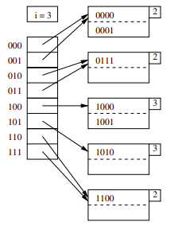
DATABASE TECHNOLOGIES
Index Structure – Hash Tables
Example of Insertion into Extensible Hash Tables:
Consider inserting records whose key hashes to the sequence 0000 and 0111
Since the first bit is 0, both the record belong in the first block.
Split the block, with 0000 and 0001 staying and 0111 going to the new block.
The entry for 01 in the bucket array is made to point to the new block
2 in the “nub” of the block indicates that two bits are used to determine membership

Slide 18
DATABASE TECHNOLOGIES
Index Structure – Hash Tables
Linear Hash Tables:
Linear hashing grows the number of buckets slowly compared to Extensible hashing
The number of buckets n is always chosen so the average number of records per bucket is a fixed fraction, say 80% of the number of records that fill one block
Since blocks cannot always be split, overflow blocks are permitted, although the average number of overflow blocks per bucket will be much less than 1
The number of bits used to number the entries of the bucket array is Γ log₂ n˥, where n is the current number of buckets. These bits are always taken from the right (low-order) end of the bit sequence that is produced by the hash function.

Slide 19
DATABASE TECHNOLOGIES
Index Structure – Hash Tables
Linear Hash Tables:
Suppose i bits of the hash function are being used to number array entries, and a record with key K is intended for bucket a₁a₂ ··· a_{i}
a₁a₂ ··· a_{i} are the last i bits of h(K).
Let a₁a₂ ··· a_{i} be m, treated as an i-bit binary integer.
If m < n, then the bucket numbered m exists and place the record in that bucket.
If n ≤ m < 2^{i} then the bucket m does not yet exist, so place the record in bucket m − 2^{i−1}

Slide 20
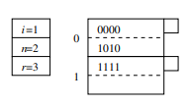
DATABASE TECHNOLOGIES
Index Structure – Hash Tables
Example of Linear Hash Table:
Consider a linear hash table with n = 2 using only one bit of the hash value to determine the buckets of records.
The hash function h produces 4 bits, the records are represented by the value produced by h
There are two buckets, each consisting of one block.
The buckets are numbered 0 and 1. All records whose hash value ends in 0 go in the first bucket and those whose hash value ends in 1 go in the second

Slide 21
DATABASE TECHNOLOGIES
Index Structure – Hash Tables
Example of Linear Hash Table:
The ratio r/n will be limited so that the typical bucket will need about one disk block
Choose n, the number of buckets, so that there are no more than 1.7n records in the file; i.e., r ≤ 1.7n.
Since blocks hold two records, the average occupancy of a bucket does not exceed 85% of the capacity of a block.

Slide 22
DATABASE TECHNOLOGIES
Index Structure – Hash Tables
Insertion into Linear Hash Table:
Compute h(K), where K is the key of the record, and use the i bits at the end of bit sequence h(K) as the bucket number, m block.
If m < n, insert the record in bucket m
if m ≥ n, put the record in bucket m − 2^{i−1}
If there is no room in the designated bucket, create an overflow block, add it to the chain for that bucket, and insert the record there.
Each time a record is inserted, compare the current number of records r with the threshold ratio of r/n, and if the ratio is too high, add the next bucket to the table.

Slide 23
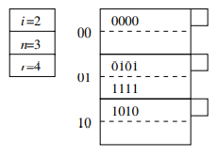
DATABASE TECHNOLOGIES
Index Structure – Hash Tables
Example of Insertion into Linear Hash Table:
Consider a record whose key hashes to 0101 to be inserted.
Since the bit sequence ends in 1, the record goes into the second bucket. There is room for the record, so no overflow block needs to be created.
However, since there are now 4 records in 2 buckets, we exceed the ratio 1.7, therefore raise n to 3. Since Γ log₂ 3 ꓶ = 2, need to change buckets 0 and 1 as 00 and 01

Slide 24
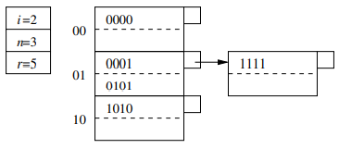
DATABASE TECHNOLOGIES
Index Structure – Hash Tables
Example of Insertion into Linear Hash Table:
Consider a record whose key hashes to 0001 to be inserted.
Since the bit sequence ends in 01, the record goes into the second bucket.
Since bucket’s block is full, an overflow block needs to be added
The three records are distributed among the two blocks of the bucket
Since the ratio of records to buckets (5/3) for the table is less than 1.7, do not create a new bucket.

Slide 25
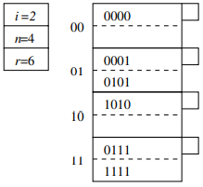
DATABASE TECHNOLOGIES
Index Structure – Hash Tables
Example of Insertion into Linear Hash Table:
Consider a record whose key hashes to 0111 to be inserted.
The bit sequence ends in 11, but bucket 11 does not exist.
Therefore redirect this record to bucket 01, The new record fits in the overflow block of this bucket
Since the ratio of the number of records to buckets exceeds 1.7, create a new bucket, numbered 11
Split the four records in bucket 01, with 0001 and 0101 remaining, 0111 and 1111 going to the new bucket.
Since bucket 01 now has only two records, delete the overflow block.

Slide 26
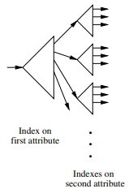
DATABASE TECHNOLOGIES
Index Structure – Hash Tables
Multiple key indexes:
SELECT * FROM R WHERE x = ‘A’ AND y = ‘B’
Use nested indexes on different keys
The “root of the tree” is an index for the first of the two attributes. This index could be any type of conventional index, such as a B-tree or a hash table
The index associates with each of its search-key values for the first attribute and a pointer to another index
If V is a value of the first attribute, then the index we reach by following key V and its pointer is an index into the set of points that have V for their value in the first attribute and any value for the second attribute.

Slide 27
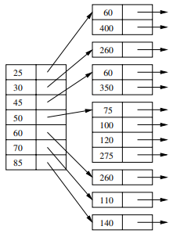
DATABASE TECHNOLOGIES
Index Structure – Hash Tables
Performance of Multiple key indexes:
SELECT * FROM EMPLOYEE WHERE AGE = 50 AND SALARY > 50
Partial-Match Queries
If the first attribute is specified, then the access is quite efficient. Use the root index to find the one subindex that leads to the records needed
SELECT * FROM EMPLOYEE WHERE SALARY > 50
If the first attribute does not have a specified value, then search every subindex, a potentially time-consuming process
Range Queries
Multiple-key index works quite well for a range query, provided the individual indexes themselves support range queries on their attribute

Slide 28
THANK YOU
Suresh Jamadagni
Department of Computer Science and Engineering
sureshjamadagni@pes.edu

